Slide 1
Flask Templates and CRUD Apps
Overview
In this lesson, students will learn to expand their Flask applications to include templates.
Duration 120 minutes
Learning Objectives
In this lesson, students will:
Use Flask to render templates with local variables
Understand and implement RESTful routes

Slide 2
Pre-Class Materials and Preparation
For remote classrooms: Virtual breakout rooms and Slack may be needed to facilitate the partner exercise and discussions. As you plan for your lesson:
Consider how you’ll create pairs for the partner exercise (randomly, or with pre-assigned partners).
Determine how (if at all) exercise timing may need to be adjusted.
For helpful tips, keep an eye out for the For remote classrooms tag in the speaker notes.
Prepare screenshots and answers to exercises in advance so that they can be easily shared in Slack during your lecture.
A note on timing: This lesson allows for a particularly long practice time, so if students are still struggling with lists or dictionaries from Lesson 2, feel free to review those before beginning with the new material.

Slide 3
Suggested Agenda
Time | Activity
0:00–0:30 | Flask Templates and CRUD Apps
0:30–0:45 | Example Template Walkthrough
0:45–1:00 | Show Route
1:00–1:30 | Index Route
1:30–1:50 | Create Route
1:50–2:00 | Wrapping Up, Q&A, and Exit Ticket Completion

Slide 4
Jupyter Notebook
The exercises referenced in this lesson can be found in the Python Workbooks + Data folder.

Slide 5
Flask Templates and CRUD Apps
Notes:
Duration: 15 minutes

Slide 6
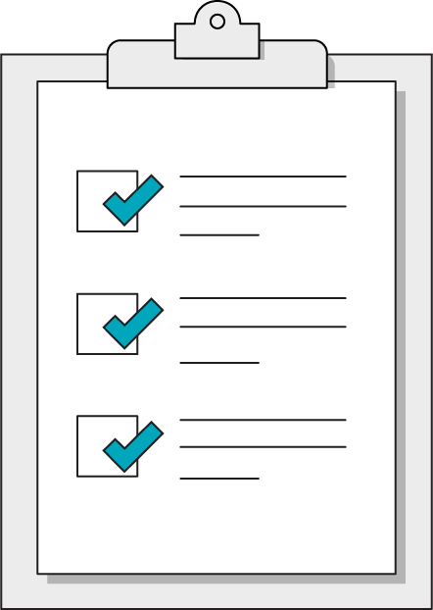
Our Learning Goals
Use Flask to render templates with local variables and programming logic
Understand the structure of a CRUD App in Flask
Notes:
Purpose: Set expectations for the lesson.
For remote classrooms:
Capture a screenshot of this slide and drop it in the class Slack channel.

Slide 7
Two Paths for Flask Applications
Rendering Templates
Database Backed Apps
Flask can be used to power web applications that render dynamic HTML pages.
Using a templating library, such as jinja, we can use Flask to "fill in the blanks" on specific pages with data from our Flask app.
Flask can use Python libraries to connect with databases, such as SQL.
By attaching a database to a Flask app, we can create APIs that allow users to manage persistent resources.
vs.
Notes:
Purpose: The difference between Rendering Templates and Database Backed Apps

Slide 8
Recap: The Seven RESTful Routes
URL Path | Method | Name | Purpose
"/reviews" | GET | index | Show the home page for this collection
"/reviews" | POST | create | Add a new item to a collection
"/reviews/<id>" | GET | show | Show details of a specific item
"/reviews/<id>" | PUT | update | Update details of a specific item
"/reviews/<id>" | DELETE | delete | Delete an item
"/reviews/new" | GET | new | Show the form to create a new item
"/reviews/<id>/edit" | GET | edit | Show the form to update a specific item
Notes:
Purpose: Review of the Seven Restful Rotues
TALKING POINTS
This is one of the tables worth memorizing if you're going to do API or web development. These seven routes insure all your bases are covered when it comes to how a user might want to interact with your application.
Note that the bottom two are only required for creating a full web-browser application on Flask, while data APIs only require the first five.

Slide 9
CRUD Applications
To cover all our bases, applications typically ensure that users can perform a full range of actions on specific collections of data:
Create resources
Read information from the collection
Update resources
Delete resources
In this lesson, we'll learn to set up Flask routes that enable CRUD functionality in our web applications by starting an application for book reviews.
Notes:
Purpose: Defining CRUD Applications
TALKING POINTS:
Making a CRUD app is a major milestone towards learning web development. We may only want to set up APIs to allow general users to interact with our databases in specific ways, not necessarily to power full web applications.

Slide 10
HTML Crash Course
Flask Templates and CRUD Apps
Notes:
Take about 10 minutes to run through the basics of HTML This shouldn't be an emphasis in the course, we're learning just enough to understand how Flask treats templates.

Slide 11
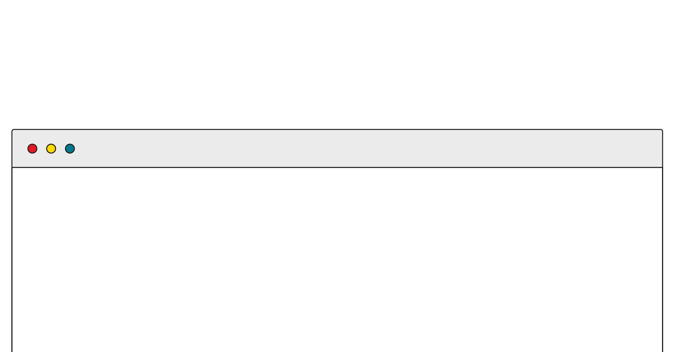
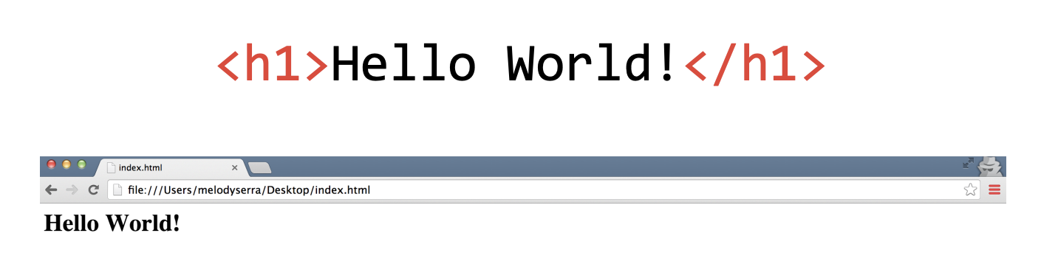
HTML: Hypertext Markup Language
HTML is made up of tags.
Tags tell the browser how to encode the content (e.g., will the content be formatted as an image or as a link?)
< >
These symbols surround every tag.
Notes:
Purpose: How HTML connects to tags
TALKING POINTS:
HTML is made of tags — the double carets you see — which tell the browser how to format the content.

Slide 12
HTML Basics
<!DOCTYPE html>
<html>
<head>
<title>GA</title>
</head>
<body>
<p>Hey GA!</p>
</body>
</html>
<html> tag ALWAYS encloses the entire document
The doctype for all HTML documents is the same:
<!DOCTYPE html>. It is ALWAYS the first item on a page.
<head> and <body> tags are where page content go. The <head> contains what machines see, <body> is what people see.
Notes:
Purpose: HTML Basics
TEACHING TIPS:
This is the boilerplate for HTML. If you’ve had students install a text editor, this is a good time to show them the hotkey for an HTML boilerplate file, or save it for later in the day. This shows them that text editors can be very powerful tools for productivity and will get some more interested in shortcuts. If you type this out in your code editor for them, you can also show them autocompleting tags so they don’t have to type out the brackets.

Slide 13
Common Body Tags
Element | Description | Example
h1 | Main headings | <h1>The Explorer</h1>
h2–h6 | Subheadings | <h2>Articles</h2>
p | Paragraph of text | <p>This is a really cool site.</p>
a | Anchor tag for links to other web addresses | <a href=”google.com”> Search for stuff </a>
img | Images | <img src=”pic.jpg”>
Notes:
Purpose: Common body tags used
TALKING POINTS:
Without HTML, all text renders at the same level. We want to create hierarchy and structure to our site, so we start with indicating which text is a header, a subheader (of multiple levels), or just plain old paragraph text. Anchor and image tags can create connections between our webpage and other sites or image files.
TEACHING TIPS:
Walk students through the elements above.

Slide 14
Common HTML Tags: Lists
Element | Description | Example
li | List item | <ul> <li>Monday</li> <li>Tuesday</li> <li>Wednesday</li> </ul>
ul | Unordered list
ol | Ordered list | <ol> <li>Monday</li> <li>Tuesday</li> <li>Wednesday</li> </ol>
Notes:
Purpose: HTML tag list
TALKING POINTS:
Next, let’s talk about adding another element to your page: lists. Lists are either unordered (with plain bullets) or ordered (with numbers). Ordered or unordered list tags will tell your browser to display the list item with a bullet or a number.

Slide 15
Rendering Templates
Flask Templates and CRUD Apps
Notes:
Duration: 25 minutes

Slide 16
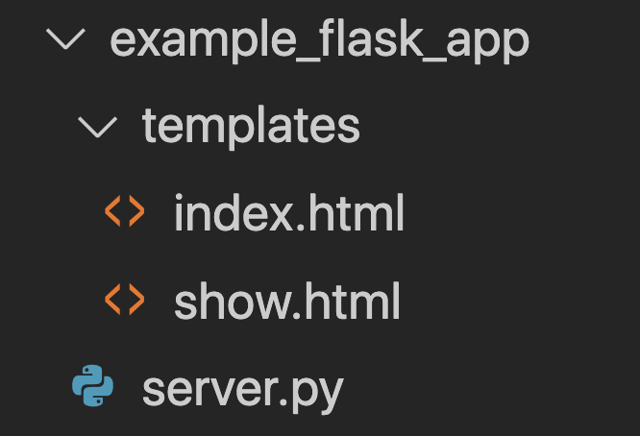
Setting Up Templates in Flask
Even though Python is not a front-end technology, we can still use a Flask app to collect and send HTML files to user's browsers in a web application.
Wherever your Flask application file lives, we'll need a folder named templates that's accessible at the same level as the main server file.
Notes:
Purpose: How to set up a template in flask
TALKING POINTS:
Now that we’ve had chance to review the basics of HTML let’s talk about templates.
Templates in Flask serve as the main server file

Slide 17
Template Syntax
Templates are HTML documents that take advantage of a templating library to use fill-in-the-blank variables. Jinja, the templating library provided by Flask as a default, uses double curly braces to set apart template variables.
<p>Welcome to the website, {{username}}</p>
Notes:
Purpose: Defining Template Syntax

Slide 18
Rendering Templates
Flask provides us with a render_template function to render templates. The first argument for this function is the html file we want to render. By default, Flask will start by looking in the folder named templates.
render_template("example.html", username="professor_z")
We can also provide keyword arguments in order to inject variable values into the template for rendering. This is how the blanks get filled in!
<p>Welcome to the site, {{username}}</p>
The user will see: "Welcome to the site, professor_z"
Notes:
Purpose: How to Render templates in flask

Slide 19
Example Template Rendering
15 minutes
To get up and running with templates, let's start up the example Flask server provided and visit localhost:5000/example to see the template rendering in action.
We can also experiment with changing the value of the keyword arguments and adding more variables to the template.
Notes:
Purpose: Walkthrough of Template Rending
TALKING POINTS:
Starting and stopping the Flask server will likely produce some errors. Encourage students to be specific with their error messages, try googling it in front of them to find a solution. Odds are somebody will have an "address in use" error from not shutting down servers correctly, which can be solved by killing the process on the specific flask port 5000.

Slide 20
Show Route
15 minutes
Let's create the route for showing a specific review in our reviews app.
Since this route leads to a specific item, we'll need a route parameter to tell us which review the user wants. We'll need to include this parameter in how we define the route url and as an argument to the route handler function.
Notes:
Purpose: Partner exercise for template rendering
TALKING POINTS:
Note that we can either provide multiple keyword arguments to the render_template method, or pass the review object and extract the individual data in the template. render_template("show.html", title=review.book_title, text=review.review_text) OR just render_template("show.html", review=review) then use {{review.book_title}} in the template.
For Remote Classrooms
Set up breakout rooms for student pairs/groups. Screenshot slide and post in Slack Channel before opening Rooms.
At the 60 second mark, send a message to all rooms “Start to wrap up your discussions. Rooms will close in 1 minute!”
Move around from breakout room to breakout room to “walk around the classroom”.

Slide 21
Programming Logic in Templates
Besides injecting variables, templates are also useful for their ability to use programming logic, such as conditionals and loops, in an HTML page.
In Jinja templates, we can set programming lines apart from our actual HTML text with the following syntax:
{% for number in [1,2,3] %}
<p>{{number}}</p>
{% endfor %}
Notes:
Purpose: How to use Jinja templates
TALKING POINTS:
The end for statement defines the end of the programming block. Note the same pattern emerges with if/elif/endif statements.

Slide 22
Index Route
15 minutes
Now that we can loop within templates, let's fill in an index route that displays all the book reviews, including titles and text, in the template.
Notes:
Purpose: How to use reviews index
For Remote Classrooms
Screenshot the slide and drop in the Slack Channel.
For solo activities, you can choose to put people in group break out rooms (to create the “table” group that they would be in in a physical setting) or allow students to work independently in the main session.

Slide 23
Reading Complex Request Data
So far, we've handled two GET requests that simply want to see information. However, we know that CRUD apps need more complex behavior to create, updated, and delete resources. Enter the request object in Flask:
import request from Flask # include request with your other imports
@app.route("/accept_data", method="POST")
def handle_data_submission():
request.form["property"] # request.form contains the POST data
Notes:
Purpose: How to read data request
TALKING POINTS:
Note that the request object will only make sense inside of a route. Refer students to the docs for other properties that are built-in to the request, like request.method or request.path

Slide 24
Creating New Reviews
20 minutes
Create a route that accepts a POST request to "/reviews" and adds a new review to the reviews list.
You can use the desktop app Postman, or use the requests library in a separate notebook file, to help you test this route once it's set up.
Notes:
Purpose: How to create new reviews
For Remote Classrooms:
Set up breakout rooms for student pairs/groups. Screenshot slide and post in Slack Channel before opening Rooms.
At the 60 second mark, send a message to all rooms “Start to wrap up your discussions. Rooms will close in 1 minute!”
Move around from breakout room to breakout room to “walk around the classroom”.

Slide 25
Wrapping Up
Flask Templates and CRUD Apps
Notes:
Duration: 10 minutes

Slide 26
Continuing Your Flask Journey
Clearly, we've just begun when it comes to developing full Flask applications. Here are just a few next steps to continue building out the reviews app:
Add anchor tags (a.k.a. links) to your templates to ease navigation
Learn how HTML forms can be used to send HTTP requests
Create a New Review form that sends the create request instead of curl
Implement the rest of the 7 RESTful routes
Use Flash messages to send form response information to users
Apply redirects to respond to users by sending them to a different route
Implement error handling including redirects to an error page
Use SQLAlchemy or PeeWee to connect with a SQL database
Notes:
Purpose: These are all just options for where students could go next with Flask. They all involve continuing to learn new topics, so they shouldn't stress if this looks like a long list of things they can't do yet.

Slide 27
Recap
Looking Ahead
In today’s class, we…
Used Flask to render templates with local variables
Used the request sub-package to parse complex HTTP POST requests
Next Class:
Web Development unit lab, creating a Flask application that will accept user requests managing a data collection.
Notes:
Purpose: Recap what was covered in the lesson.

Slide 28

Don’t Forget: Exit Tickets!

